Slide 1
Monday 4 September 2023
12.00 arrivals, 12.30-13.15 ceremony (Greek time)
Stelios Foundation Conference Hall, Plaka, Athens
NB Ceremony via zoom 12.30-13.15 will be recorded

Slide 2
Why is giving awards to entrepreneurs
giving back to society in Greece?

Slide 3
easyGroup®
Stelios’ business ‘for profit’ side
creator and owner of the
easy® family of brands
Find us on easy.com
The easy® portal

Slide 4
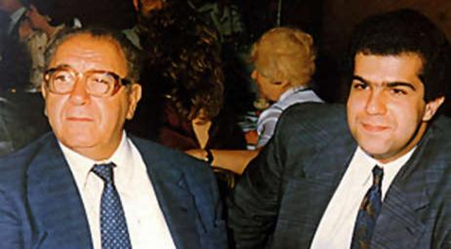
Creating easy
In 1994 Stelios started creating the easy family of brands at the age of 27! First flight 10 Nov 1995!
(With financial help from his father Loucas)

Slide 5
The easy family of brands
the business model for steady income
Stelios’ private investment vehicle easyGroup kept the ownership of the easy brand after the airline’s IPO in 2000. Stelios and his family own 15% of the shares of easyJet PLC. By licensing out to carefully selected partners, the easy® family of brands (including easyJet and easyHotel) is generating a steady income stream which is more predictable than share price movements.Other easy brands available to the Greek market : easySim.global , easyCar.com, easyFerry.com, easyHemp.gr , easyStudies.gr and easyCinema.gr

Slide 6
Creating easy
https://easyhistory.info/
In 1994 Stelios created the easy family of brands at the age of 27! First flight 10 Nov 1995!
(With financial help from his father Loucas)
https://youtu.be/OSyoZQjGvNY

Slide 7
Creating easy
easyHistory 4th edition in Greek
The 4th edition easyHistory book in Greek.
Please take a copy with you.

Slide 8
1/3rd easy family of brands 1/3rd non-easy other investments 1/3rd giving back to society
Sir Stelios Haji-Ioannou’s time allocation

Slide 9
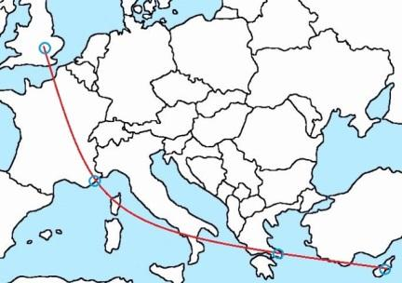
Our Mission Statement
The Stelios Philanthropic Foundation’s mission is to support a diverse range of charitable activities, primarily where the Founder has lived and worked: Greece, Cyprus, the UK and Monaco.
Or what we call “close to home”!

Slide 10
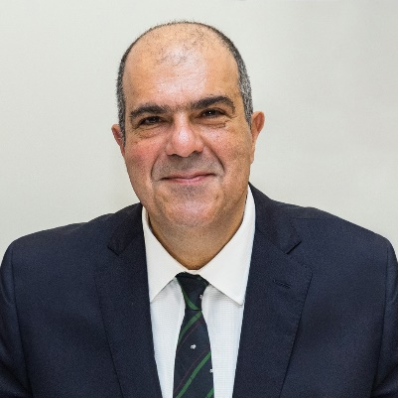
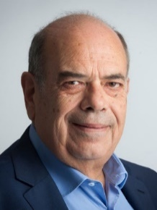
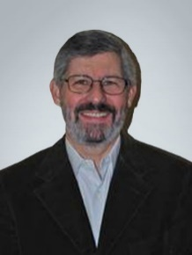
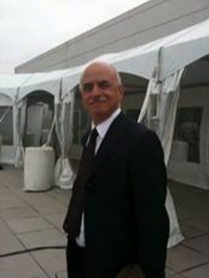
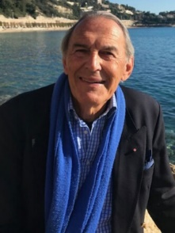
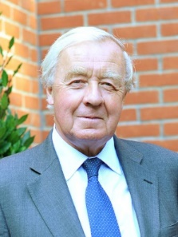
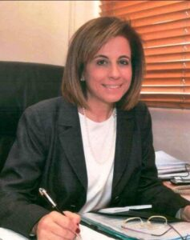
Our Trustees
Sir STELIOS
HAJI-IOANNOU
President & Founder
stelios@stelios.com
Nikos Mourkogiannis
In Greece
David Watson
In Greece
Rena Rouvitha Panou
In Cyprus
Donald Manasse
Jean-Claude Eude
Peter Barton

Slide 11
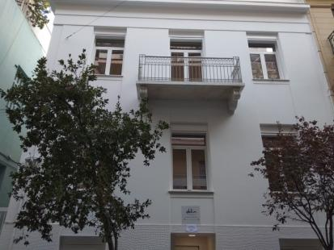
Our Foundation’s HQ in Greece
5 Alopekis Street, Kolonaki, Athens 10675

Slide 12
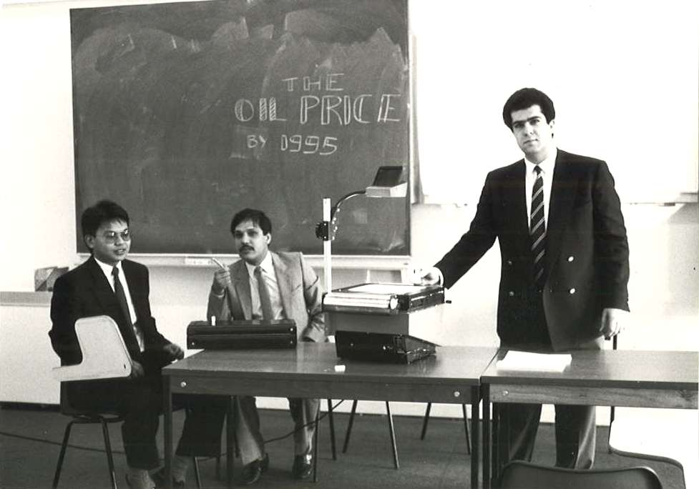
SCHOLARSHIPS
London School of Economics
Scholarships established in 2005.
133 Scholarships awarded to date.
Over £2.9 million given to Scholarships to date.
BAYES Business School, City University of London
Scholarships established in 2006.
138 Scholarships awarded to date.
Over £1.38 million donated.
Doukas High School Athens
Scholarships established in 2015.
22 Scholarships awarded to date.
Over 750k euro donated.
BCA Business College of Athens
Started 2022.
7 annual Scholarships for a “Yacht Chef certificate” on the motor yacht Klelia 1, 6.5k euro each (45k euro).

Slide 13
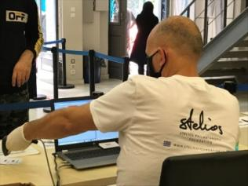
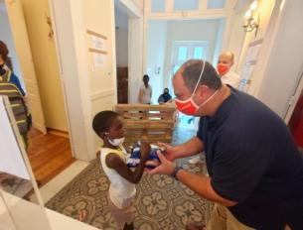
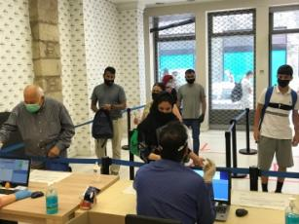
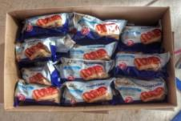
Food from the heart programme
We currently hand out 300,000 snacks to 150,000 beneficiaries in Greece and Cyprus each month.
Operating since 2013 from
11 distribution points – the Foundation has handed out more than 28,000,000 snacks to date. This is normally our most expensive recurring programme, an annual expenditure of about €1 million euros per year.

Slide 14
Donations to Other Charities in Greece

Slide 15
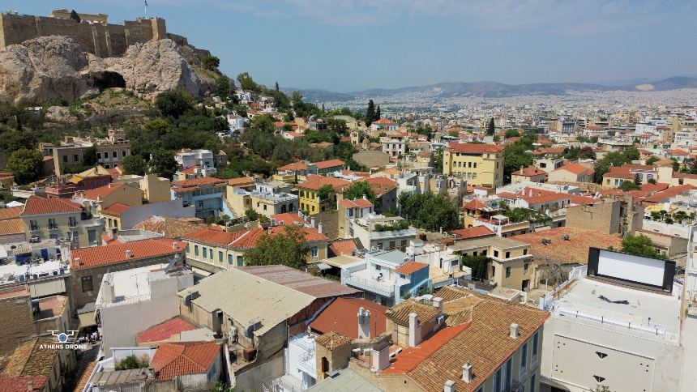
The “Stelios Foundation Conference Hall” in Plaka
Available to other charities to use for their fundraising for free. Please see the leaflet to make a request to use the space.

Slide 16
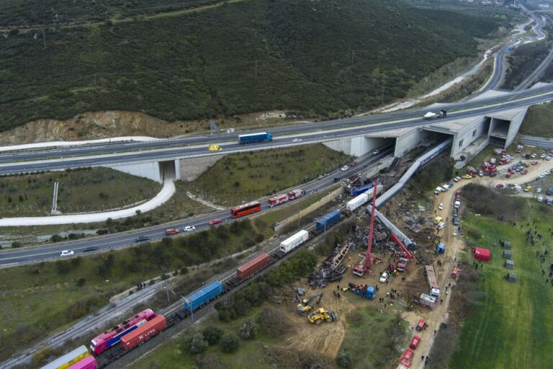
Tempi
Donation of €10,000 to each family of the deceased from the train collision on the 28 February 2023 in Tempi, Greece.
As at 3 June 2023 a total of €570,000 has been paid by bank transfer to the next of kin of 56 of the 57 deceased.

Slide 17
Criteria for the “Stelios Awards for Young Entrepreneurs in Greece 2023”
14TH YEAR €100,000 in cash prizes to be awarded
(1st prize €50,000, 2nd prize €30,000 and 3rd prize €20,000)
Entrepreneur in Greece less than 40 years old (born in 1983 or later).
Started their own business in the last 5 years.
Total turnover for 2022 should be minimum of €20,000.
Employ at least 3 staff.
Own at least 50% of the company. If there are 2 entrepreneurs at least 80% of the company.

Slide 18
Past winners of the “Stelios Awards for Young Entrepreneurs in Greece”

Slide 19
Presenting the winners of the 2023 “Stelios Awards for Young Entrepreneurs in Greece” Thank you to all 46 applicants!
So many excellent businesses and very difficult to choose the top three.
Two of the three entrepreneurs won before and therefore we encourage everyone to apply again next year.
All three businesses are from the ‘new economy’.
Two winners have built businesses which were not even imaginable a few years ago.

Slide 20
3rd prize €20,000

Slide 21
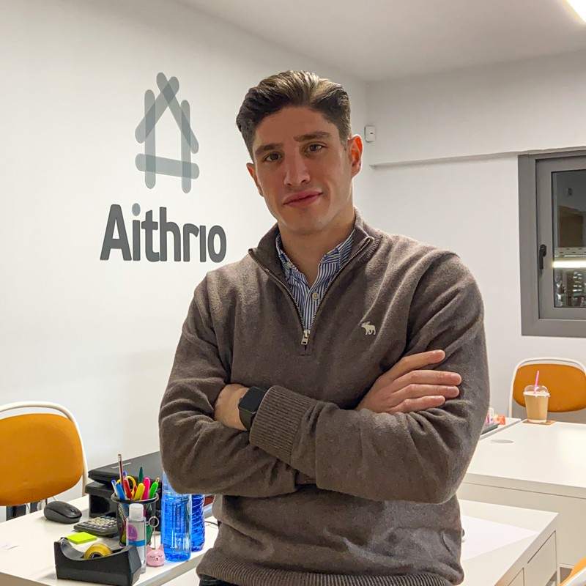
Giannis Xoxolis Προεγενέστερη οικογενειακή επιχείρηση από το 1960 Νέα επιχείρηση aithrio.com το 2017 2017 - Αναζήτηση στρατηγικής για νέα επιχείρηση Κενό στην αγορά Κανάλι Ηλεκτρονικό εμπόριο Niche αγορά μικρός ανταγωνισμός ελάχιστο κεφάλαιο Facebook για έρευνα αγοράς

Slide 22
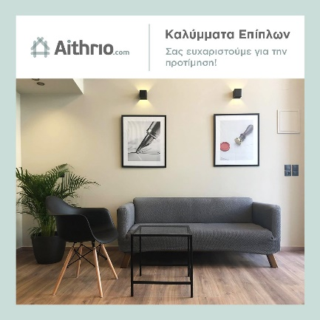
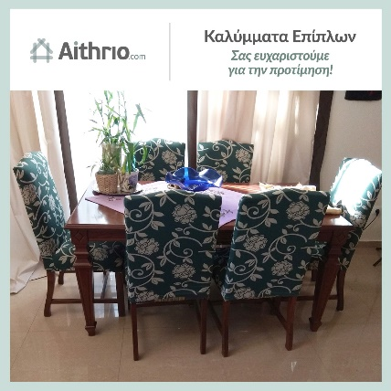
2018 - Αithrio.com - Καλύμματα Επίπλων Τα Έτοιμα Καλύμματα είναι ο εύκολος τρόπος για την προστασία και ανανέωση επίπλων με χαμηλό κόστος. Ανταγωνιστικό Πλεονέκτημα Ισπανία - Shopify Εβδομαδιαία Αγορά - Μικρό Κεφάλαιο Ποικιλία σε σχέδια και χρώματα Ανταγωνιστικές Τιμές - Ανταγωνιστικά Margins Εξειδίκευση σαν Υπηρεσία 3D Απεικονίσεις Product Mix Διερεύνηση του προϊοντικού μείγματος

Slide 23
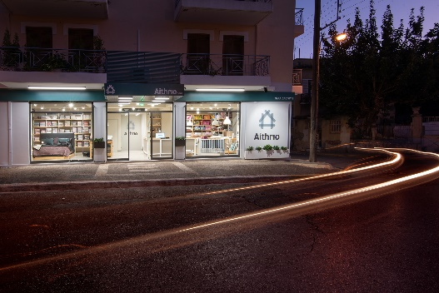
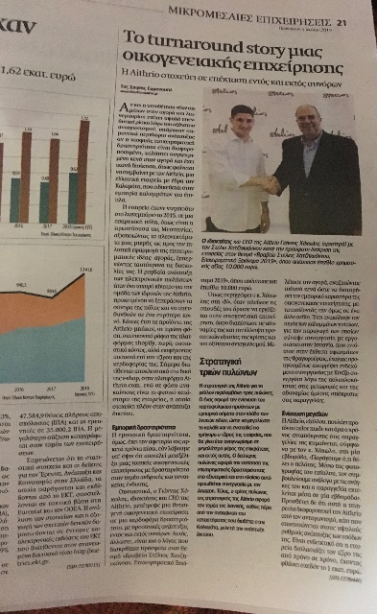
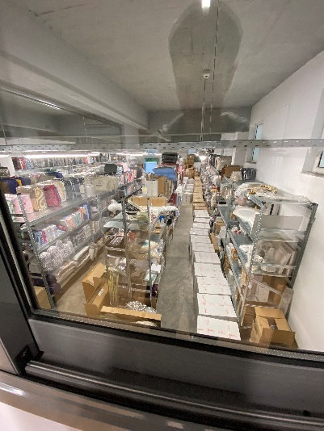
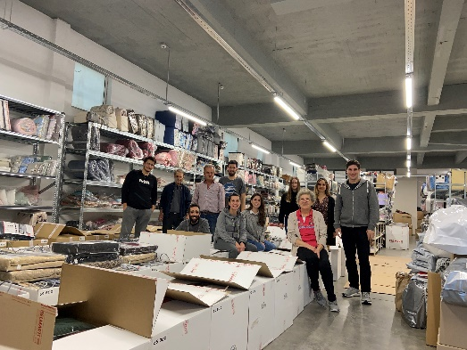
2019 - 2020 Ανακαίνιση Καταστήματος Η μεγαλύτερη εβδομαδιαία αποστολή Καλυμμάτων 10-12-2020 - 700 παραγγελίες - 50.000€ Συνέντευξη Ναυτεμπορική για την διάκριση μας στα Stelios Awards

Slide 24
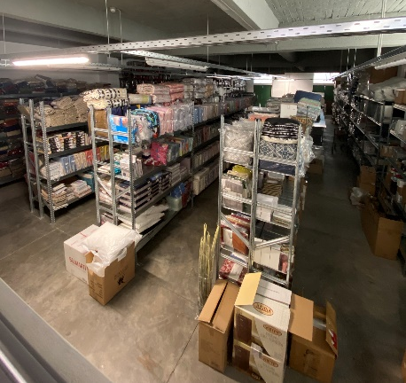
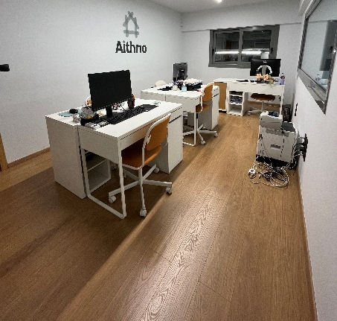
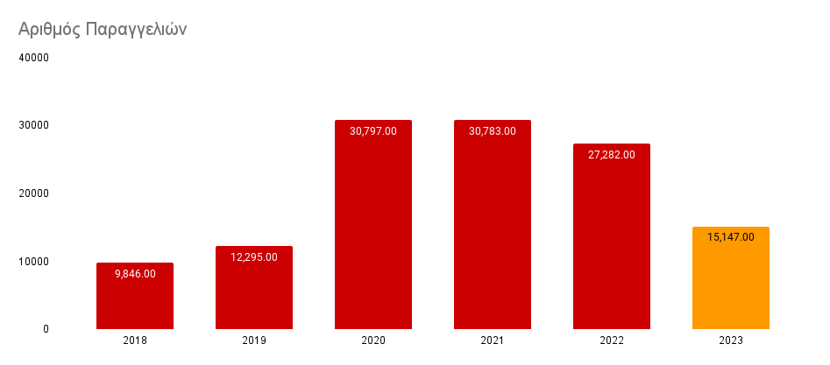
2020 –2021 Μεταφορά σε Αποθήκη - Γραφεία Απασχολεί full time 10 άτομα 42.000 Ενεργά Προϊόντα από 25 Προμηθευτές Καλύμματα Επίπλων Λευκά Είδη Διακόσμηση Ξενοδοχειακά κ.α. 2022 - 2023 Πανδημία & Διατήρηση Τζίρου

Slide 25
2nd prize €30,000

Slide 26
Chris Tsounis

Slide 27
OUR MAIN CHANNELS
Chris Tsounis
YouTube 86.000+ subscribers - 12.500.000+ views
Blog Daily news about market, stocks, etc.
Instagram TikTok Facebook
Financial Greeks
YouTube 121.000+ subscribers - 1.353.000+ views
2.000.000
Together we have reached over
Greeks
70.000
and actively helped more than
of them improve their finances.

Slide 28
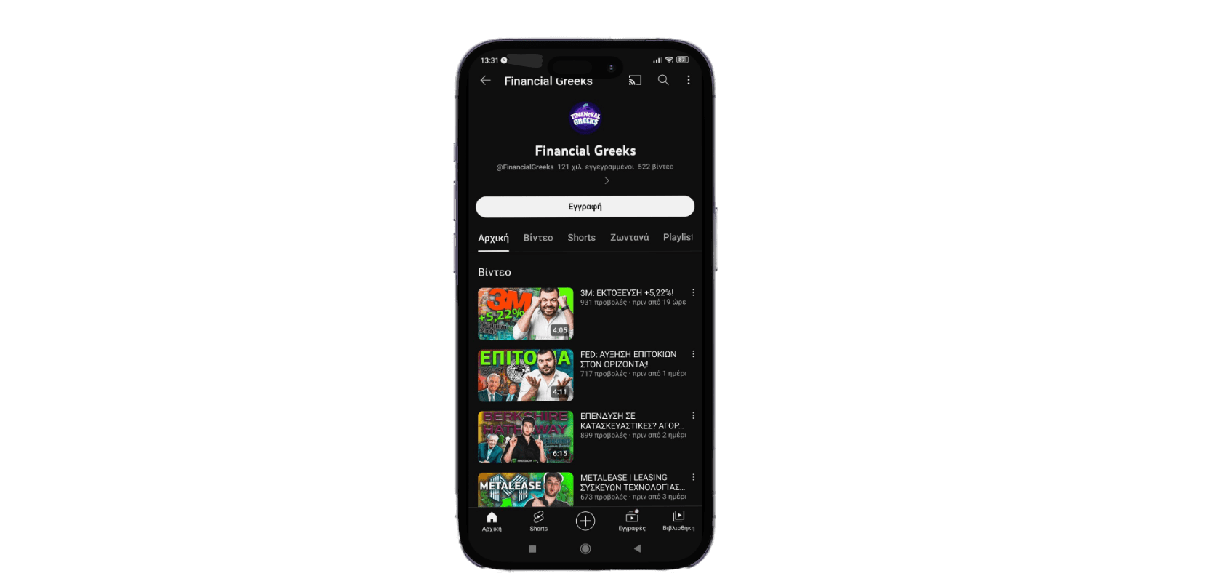
GREEK FINANCIAL INFLUENCING
Chris Tsounis
Financial Greeks

Slide 29
90.000.000+
8.000.000+
250+
PANEUROPEAN AGENCY
Views annually on YouTube
YouTube subscribers
Creators across Europe
200+
Social Media Accounts
1.250.000+
Online Community
16+
Countries

Slide 30
1st prize €50,000

Slide 33
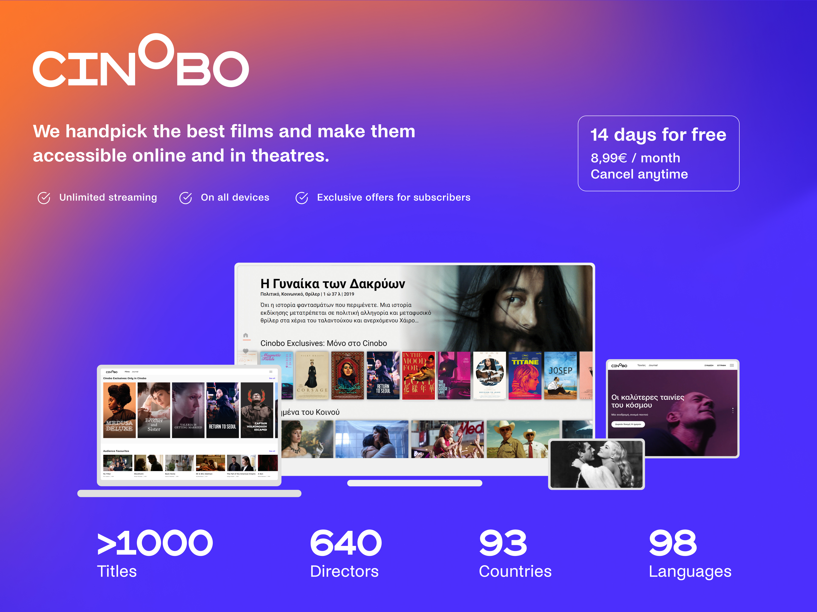

Slide 35
Partnership of cinobo with the easy family of brands
Behtsis family will operate the cine paris

Slide 36
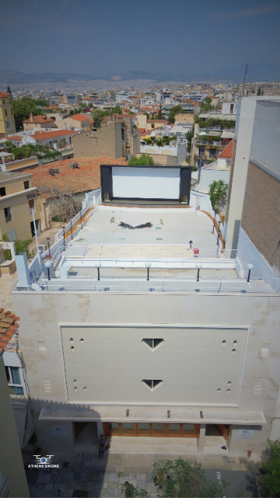
The Bechtsi family will be operating the open air cinema on the roof terrace of the stelios foundation conference hall under the brand www.Cine Paris.gr from May 2024 and paying rent to the Stelios Foundation

Slide 37
Thank you for joining us,
enjoy your lunch!
Please take a goodie bag on the way out.

